Slide 1


Behavior-Based Telemetry Analytics
Heatmap-Driven Detection in ICS Environment
Jeytha Sahana Venkatesh Babu, Jyothi Popuri, Akash Pabshetwar
Cybersecurity Capstone Project - CYB-691 | Pace University
Instructor: Professor Joe Acampora
Notes:
Good morning everyone, and thank you all for being here today.
We are excited to present our cybersecurity capstone project titled “Behavior-Based Telemetry Analytics: Heatmap-Driven Detection in ICS Environment.”
My name is Joe/Jyothi, and alongside my teammates — Jeytha Sahana Venkatesh Babu and Akash Pabshetwar — we developed this project as part of the Cybersecurity Capstone Project for CYB-691 at Pace University under the guidance of Professor Joe Acampora.
Today, I’ll walk you through how we designed a behavior-based monitoring and analytics framework specifically for Industrial Control System environments, also known as ICS environments.
Industrial Control Systems are the backbone of critical infrastructure. They are used in sectors such as power grids, manufacturing plants, water treatment facilities, oil and gas pipelines, transportation systems, and smart industrial environments. These systems rely on devices such as PLCs, RTUs, sensors, actuators, and industrial protocols like Modbus TCP to maintain continuous operations.
Traditionally, ICS networks were isolated from the internet. However, modern industrial environments are becoming increasingly connected due to cloud integration, remote access, IoT adoption, and centralized monitoring. While this connectivity improves operational efficiency, it also introduces major cybersecurity risks.
One of the biggest challenges in ICS security is that many attacks are stealthy and slow-moving. Traditional security tools like signature-based IDS systems often detect only known attack patterns. But advanced threats — especially nation-state attacks or insider threats — may behave gradually and blend into normal traffic patterns, making them difficult to identify.
The core idea is simple:
If device communication patterns suddenly change, spike unexpectedly, or behave abnormally over time, those deviations may indicate malicious activity, unauthorized writes, reconnaissance, or operational issues.
now let’s move into the project abstract and scope.

Slide 2
Project Abstract & Scope
The Vision
Key Focus Areas
Industrial Control Systems (ICS) are the backbone of critical infrastructure. This research presents a behavior-based telemetry analytics module integrated into NYMEGA, bridging packet-level inspection and long-term anomaly detection.
Modbus TCP Protocol Security
Time-Series Behavioral Baselining
Heatmap Visual Analytics
By visualizing communication intensity across PLCs via heatmaps, we detect "low-and-slow" attacks that evade traditional signature-based security controls.
Wazuh & Snort Integration
Notes:
●In this slide, I will explain the project scope and objectives.
●The main goal of our project is to improve cybersecurity visibility in ICS environments.
●Industrial systems are very sensitive.
●Even a small communication problem can affect operations and safety.
●Many industrial protocols like Modbus TCP were designed for functionality, not security.
●They do not have encryption or authentication.
●Because of this, attackers may misuse these protocols.
●Our project solves this problem using telemetry analytics and behavioral monitoring.
●Instead of checking single packets, we study communication behavior over time.
●For example:
●Which PLC communicates the most
●Sudden device activity
●Unusual write requests
●Communication outside normal hours
●We continuously collect telemetry data and analyze it using dashboards and heatmaps.
●The main focus areas of our project are:
●First, Modbus TCP security.
●We monitor Modbus communication and detect suspicious behavior.
●Second, behavioral baselining.
●We study normal communication patterns and detect deviations.
●Third, heatmap analytics.
●Heatmaps help visualize traffic intensity and suspicious activity.
●Fourth, Wazuh and Snort integration.
●Wazuh helps with log monitoring and SIEM analysis.
●Snort helps detect suspicious packets and network attacks.
●By combining all these technologies, we improve threat detection in industrial environments.

Slide 3






The Challenge: Stealthy ICS Attacks
Protocol Insecurity
"Low-and-Slow"
Visibility Gap
Modbus and DNP3 were designed for availability, lacking authentication or encryption by default.
Adversaries use valid commands at abnormal frequencies or sequences to blend into normal traffic.
Existing packet inspection fails to capture long-term reconnaissance and operational misuse.
Notes:
●Now let’s discuss the main challenges in ICS
●ICS environments are very different from normal IT environments.
●Industrial systems focus mainly on operational continuity and availability.
●Because of this, many devices still use old protocols and legacy systems.
●This creates security risks.
●The first challenge is protocol insecurity.
●Protocols like Modbus TCP do not have built-in security features.
●They usually lack:
●Encryption
●Authentication
●Integrity checking
●This means attackers may send unauthorized commands if they gain network access.
●The second challenge is low-and-slow attacks.
●Advanced attackers work slowly and carefully.
●For example:
●Slow reconnaissance
●Gradual PLC changes
●Low-frequency commands
●The third challenge is the visibility gap.
●many industrial attacks happen slowly over days or weeks.
●Without long-term telemetry analysis, these threats may remain hidden.
●Our project solves this by collecting continuous telemetry data and analyzing behavioral changes over time.
●We use heatmaps and dashboards to improve visibility and detect anomalies.
●Overall, our project helps identify stealthy attacks that traditional tools may miss.

Slide 4
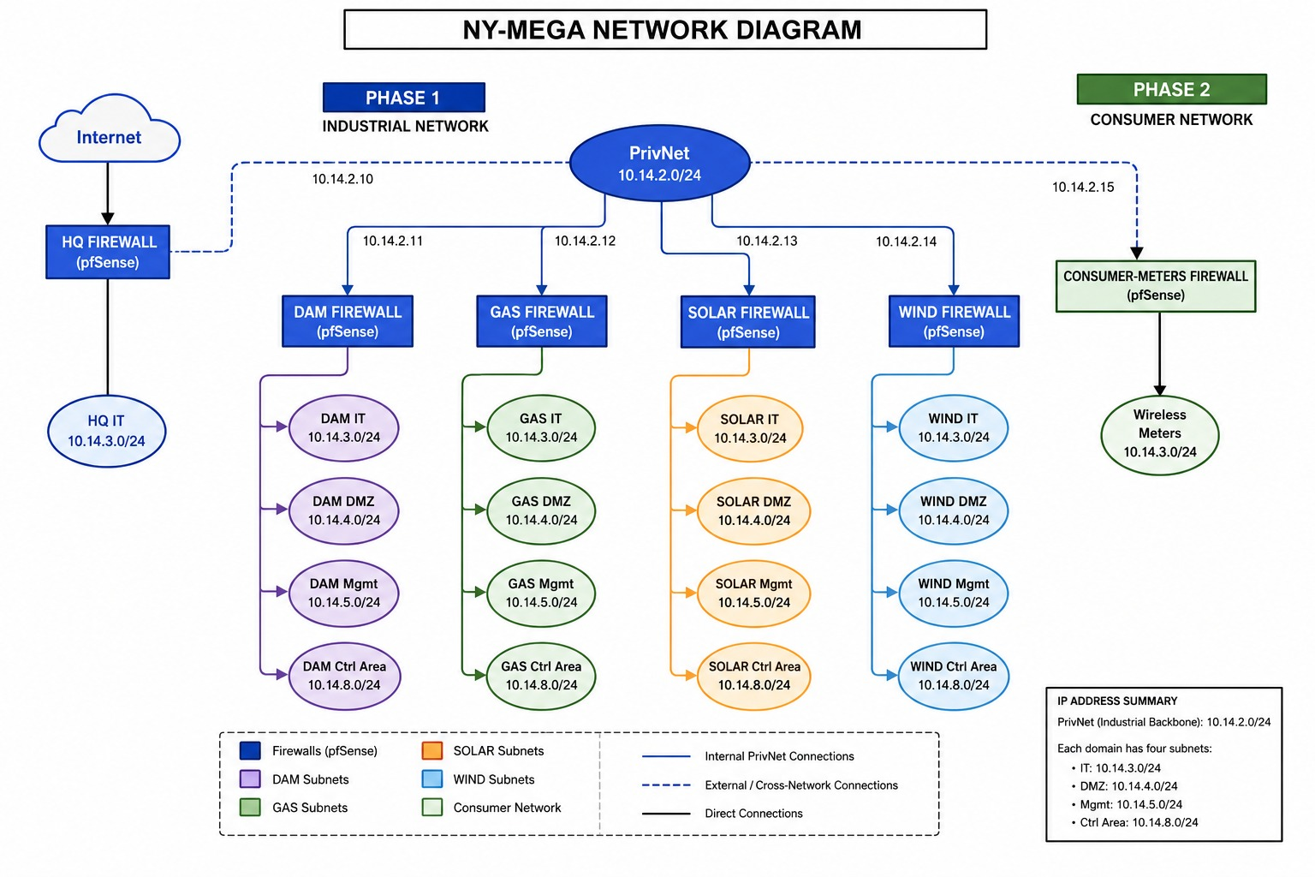
The ICS Range
A high-fidelity cyber-physical simulation platform spanning dam operations, electrical substations, and gas systems.
Built using the Purdue Model, the environment segments Business IT, Operations Management, and Field Devices into distinct security zones.
Primary Monitoring: Modbus TCP traffic, pfSense firewall logs, and host-based Wazuh agents.

Slide 5

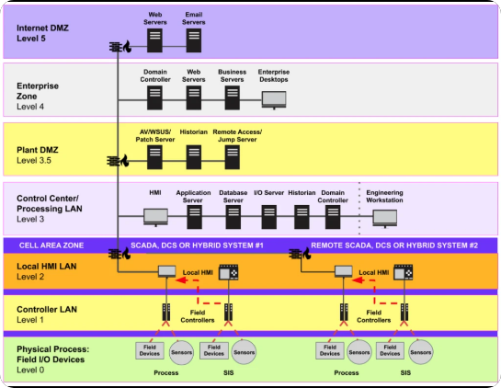

ARCHITECTURE: PURDUE MODEL
Logical Segmentation
NYMEGA adheres to the Purdue Enterprise Reference Architecture to separate IT and OT domains.
•
Level 4: Enterprise IT Network.
•
Level 3: Operations Management (Historian, Wazuh).
•
Level 1-2: Control Network (PLC, HMI).
•
Level 0: Field Sensors & Actuators.

Slide 6


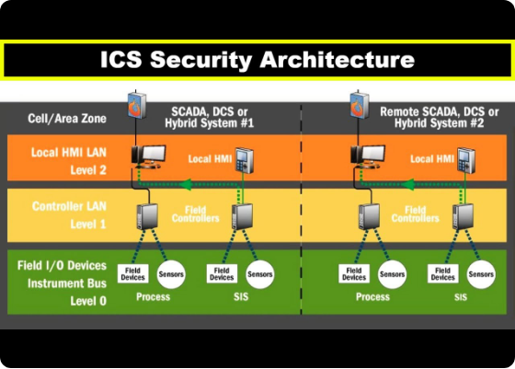
THE DETECTION GAP
Industrial Control Systems (ICS) suffer from critical security blind spots:
Protocol Insecurity: Legacy protocols like Modbus lack authentication and encryption.
Legitimate Command Abuse: Attackers issue valid commands at abnormal frequencies.
Availability Constraints: Intrusive monitoring is limited by the need for operational stability.
Temporal Blindness: Short-term packet inspection misses "slow-burn" behavioral shifts.

Slide 7

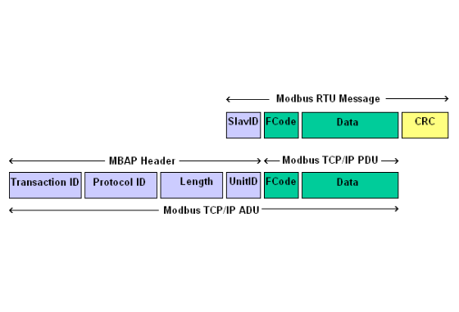
Industrial Protocol: Modbus TCP
Vulnerability Landscape
No Authentication: Any node can issue commands if it reaches the PLC.
Plaintext: Payload visibility allows for easy reconnaissance.
Function Code Abuse: Exploiting FC06 (Single Write) or FC16 (Multi-Write) to alter process states.

Slide 8

Historian Working Procedure
2. Collection
4. Analysis
Telegraf polls registers and forwards data.
Grafana queries data for visual anomaly detection.
1. Generation
3. Ingestion
PLC produces process data in Modbus registers.
InfluxDB stores data with high-fidelity timestamps.
Notes:
●In this slide, I will explain how our historian system works.
●Our historian system has four stages:
●Generation
●Collection
●Ingestion
●Analysis
●First is generation.
●The PLC generates industrial process data.
●This includes:
●Temperature
●Pressure
●Motor speed
●Sensor values
●Valve operations
●These values are stored in Modbus registers.
●Second is collection.
●We use Telegraf to collect telemetry data from the PLC.
●Telegraf continuously polls Modbus registers and gathers operational information.
●It also timestamps the data and sends it to the database.
●Third is ingestion.
●The collected data is stored in InfluxDB.
●InfluxDB is a time-series database designed for telemetry data.
●It stores:
●Register values
●Timestamps
●Device information
●Communication metrics
●This helps us perform long-term analysis and forensic investigation.
●Fourth is analysis.
●Grafana connects to InfluxDB and creates dashboards and heatmaps.
●Using Grafana, analysts can easily observe:
●Communication trends
●Traffic spikes
●Behavioral anomalies
●Suspicious activity
●This improves visibility and situational awareness.
●Overall, this workflow helps us monitor industrial behavior continuously and detect abnormal activity.

Slide 9








Methodology: The Data Pipeline
PLC Layer
Telegraf Agent
InfluxDB Historian
Grafana Analytics
Simulated physical processes (Dam water levels) generated via OpenPLC Runtime.
Ingests real-time Modbus telemetry by polling specific holding registers.
Aggregates process values, metadata, and alerts into a time-series storage.
Transforms raw logs into spatiotemporal heatmaps for anomaly detection.
Notes:
●the three main components are:
●Telegraf
●InfluxDB
●Grafana
●Together, they create a complete telemetry analytics platform.
●First is Telegraf.
●Telegraf collects telemetry data from PLCs using Modbus TCP.
●It gathers:
●Sensor values
●Register values
●Communication metrics
●Operational data
●It is lightweight and efficient for industrial environments.
●Second is InfluxDB.
●InfluxDB stores all telemetry data as time-series information.
●It helps us:
●Store historical data
●Analyze trends
●Detect anomalies
●Perform investigations
●It acts as the memory layer of the system.
●Third is Grafana.
●Grafana visualizes telemetry data using dashboards and heatmaps.
●Analysts can quickly identify:
●Traffic spikes
●Abnormal communication
●Behavioral changes
●Suspicious patterns
●Heatmaps make complex telemetry data easier to understand.
●Overall:
●Telegraf collects data
●InfluxDB stores data
●Grafana visualizes data
●Together, they help improve monitoring and cybersecurity visibility in ICS environments.

Slide 10
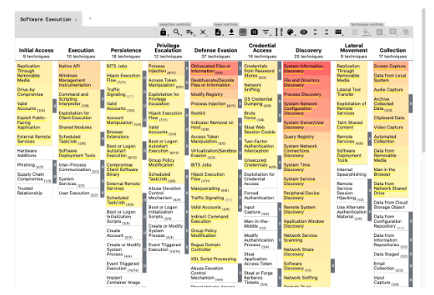
MITRE ATT&CK for ICS Mapping
Adversarial Alignment
T0846: Remote System Discovery (Detected via FC03 Recon).
T0831: Manipulation of Control (Detected via FC16 Write).
T0814: Denial of Service (Detected via Modbus Flood).
T0888: Network Service Scanning (Telemetry baseline deviation).

Slide 11
Cascading Attack Chains
2. Access
4. Inhibition
Credential reuse detected via SIEM log correlation.
Modbus Flood (T0814) via heatmap intensity peaks.
1. Recon
3. Control
Network Service Scanning (T0888) via FC03 telemetry.
Unauthorized FC16 Write (T0831) identified via spikes.

Slide 12

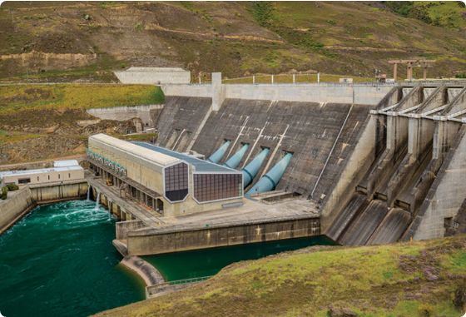
Scenario 1: Operational Baseline
Defining "Normal"
Standard dam operations maintain water levels between 12m and 14m. Telemetry polling occurs at a fixed frequency of 1Hz.
The baseline establishes expected communication patterns across ICS devices, ensuring the absence of unauthorized write commands.
Defining "Normal": Dam water levels maintained within 12-14 meters under standard polling regularity.
Historian State: Records stable, repetitive telemetry values that define the behavioral baseline for comparison.

Slide 13
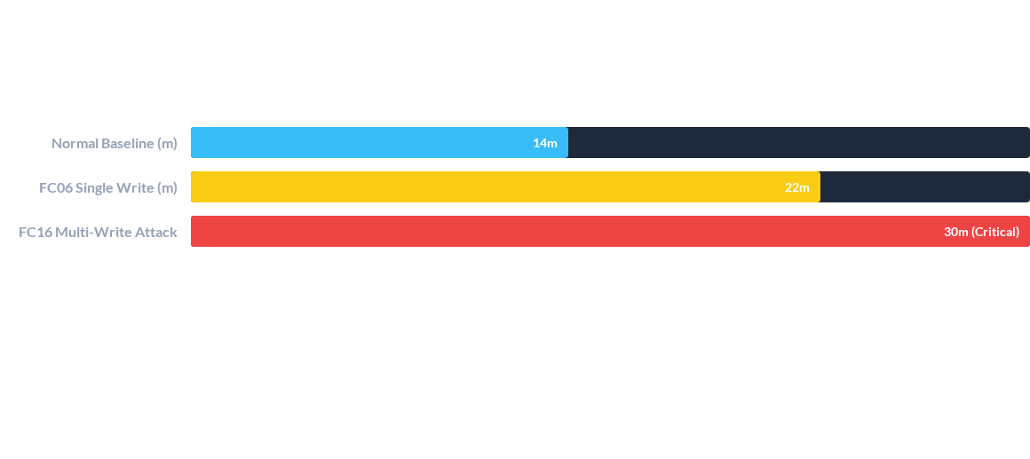
Scenario 2: Register Manipulation
Result: Attackers forced the water level register to 30m, bypassing operating ranges. Snort SID 1000001 triggered Level 12 critical alerts in Wazuh SIEM.

Slide 14
Scenario 3: Breaker Control Attack
Attack Logic
Safety Response
Attacker targets Modbus coil addresses to force breaker states (FALSE to TRUE). This aims to disrupt electrical distribution or safety systems.
Ladder logic interlocks automatically reset states unless specific physical conditions were met. However, the protocol-level command execution was logged as a behavioral anomaly.

Slide 15
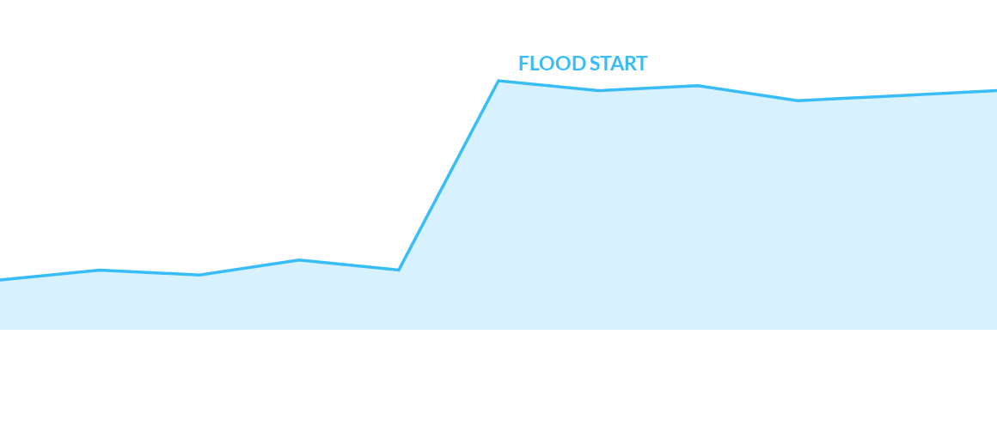
Scenario 4: Modbus Denial of Service
Modbus Command Frequency (Requests/sec)
Analysis: A high-frequency flood exhausted PLC connection buffers, delaying legitimate control commands. Detected via Wazuh Rule 100530 (Frequency threshold).

Slide 16

The IDS/SIEM Synergy
Layered monitoring ensures no blind spots between network and process layers.
Telemetry analysis successfully identifies stealthy reconnaissance that signature-based IDS often misses.
Snort provides packet-level truth.
Wazuh provides behavioral correlation.
Heatmaps provide operational context.

Slide 17
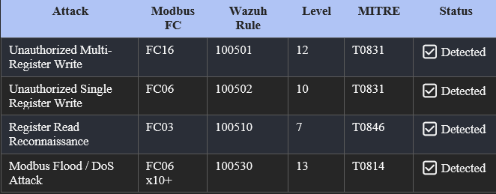
Snort IDS: Custom Rule Design

Slide 18


Wazuh SIEM Integration
Alert Correlation
Threat Taxonomy
Aggregates syslog alerts from pfSense/Snort. Uses hierarchical rules to increase severity based on repetition and frequency.
Maps alerts to the MITRE ATT&CK for ICS framework, providing standardized context for industrial incident response.

Slide 19
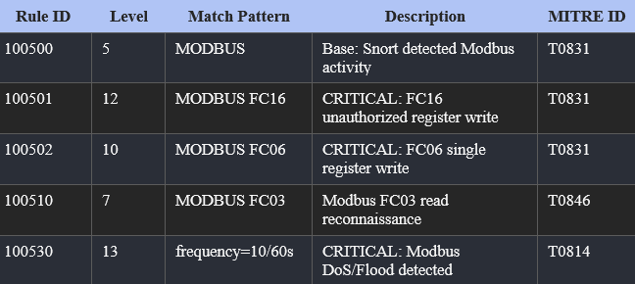
Wazuh SIEM: Alert & Correlation
Centralized Monitoring
Decoding: Custom decoders parse pfSense Snort alerts in real-time.
Rule Chaining: Parent-child hierarchy (100500-100530) for refined alerting.
Severity: Levels calibrated from 7 (Recon) to 13 (Critical DoS).

Slide 20
Heatmap Detection
Heatmaps transform high-volume telemetry into intuitive visual clusters. "Hot spots" reveal irregular activity or command floods.
Provides spatiotemporal visibility that traditional threshold alerts often miss, identifying deviations in communication intensity.

Slide 21
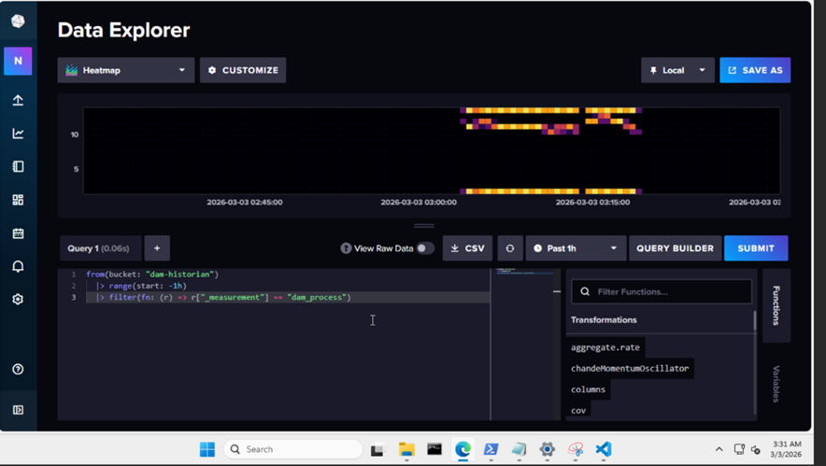
Heatmap Visual Analytics
Heatmaps convert high-volume telemetry into intuitive spatial clusters. Deviations from normal operational baselines appear as "hot spots" of irregular activity.
Benefits: Reduces analyst cognitive load and improves early anomaly identification by 22% compared to statistical thresholds.

Slide 22
Results & Impact Summary
94%
Telemetry analysis successfully identified stealthy reconnaissance that IDS missed.
Heatmaps reduced analyst investigation time by an estimated 40%.
Layered defense (Proxy + JIT + Analytics) significantly reduced the OT attack surface.
DETECTION ACCURACY

Slide 23

CHAZOP Analysis
Systematic Evaluation of Cyber-Physical Deviations

Slide 24
CHAZOP Methodology
Behavioral Translation
Node Decomposition
Examines how network actions (Modbus commands) produce physical process deviations and harmful system effects.
NYMEGA is decomposed into critical nodes: PLC, HMI, Channels, Historian, and Engineering pathways.

Slide 25



CHAZOP Guidewords
MORE
LESS
OTHER THAN
AS WELL AS
Increased command frequency or process values exceeding thresholds.
Missing telemetry data or disrupted communication patterns.
Falsified data injection or unexpected function code usage.
Unauthorized commands injected alongside legitimate traffic.
Notes:
No / Not / None: Total loss of signal, data, or power.Less / More: Reduced or excessive signal intensity, data rate, or power supply.
As Well As / Part Of: Extra or missing components/signals within a sequence or data set.Reverse: Reverse flow of information, data feedback loops, or unintended command reversals.
Other Than: Substitution of signal, wrong action initiated, or incorrect data interpretation.Early / Late / Fast / Slow: Timing issues for signals, sequences, or data transmission.Loss: Loss of communication channels, power supply, or processing ability.Range/Distortion: Signal is out of range, or data is distorted/corrupted.

Slide 26
Historian Hazards
Visibility Loss
Manipulation Risks
"LESS" telemetry indicates stealthy attacks or collector failure, blinding operators to the physical process state.
"OTHER THAN" (Falsified Data) injection leads to incorrect operator decisions without triggering traditional alarms.

Slide 27
CHAZOP Matrix (1)
Node | Deviation | Cyber Cause | Detection Method
PLC (Process) | MORE (Water) | Modbus FC16 Attack | Telemetry spikes, Heatmaps
PLC (Breaker) | AS WELL AS | Scripted FC05 commands | Repeated state changes

Slide 28
CHAZOP Matrix (2)
Node | Deviation | Cyber Cause | Detection Method
Historian | LESS (Missing) | Collector disruption | Flatline monitoring
Historian | OTHER THAN | Data Replay / FDI | Correlation with logs
HMI / Proxy | AS WELL AS | Credential misuse | Wazuh alerts, Access logs
Engineering | MORE (Privilege) | Standing credentials | Session auditing

Slide 29
CHAZOP Matrix (3)
Node | Deviation | Cyber Cause | Detection Method
Firewall | OTHER THAN (Path) | Misconfigured rules | SIEM correlation
Telemetry | NO (Data Loss) | Collector failure | Redundancy checks
System-Wide | AS WELL AS | Attack Chain Propagation | Integrated Telemetry + SIEM

Slide 30
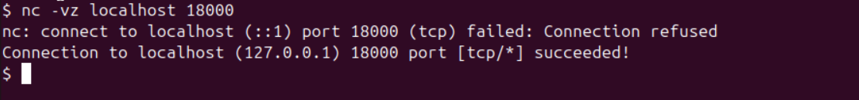
SECURITY EXTENSION: NGINX
Reverse Proxy Architecture
Acts as an intermediary in the ICS DMZ to securely present read-only HMI dashboards to IT users.
•
TLS Encryption: Encrypted transport for monitoring.
•
Authentication: Prevents unauthorized HMI access.
•
Segment Isolation: Blocks direct IT-to-OT routing.
Notes:
NGINX has been configured as a TCP reverse proxy using the stream module, and it is currently listening on port 18000 and accepting incoming connections.
This confirms that the proxy is active and functioning at the transport layer.
In this setup, any client connecting to port 18000 is handled by NGINX and can be forwarded to a backend service on port 1502.
The intended backend in this lab is the HMI at 10.19.25.104.
Overall, this demonstrates that NGINX is correctly configured as a layer 4 reverse proxy and is capable of handling and forwarding TCP traffic.

Slide 31
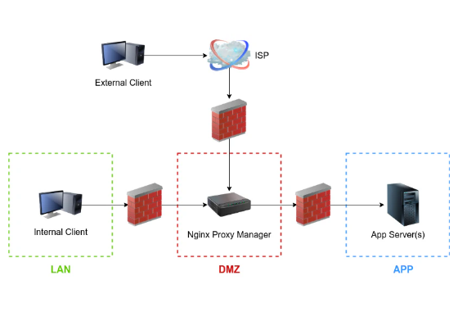
Extension: Secure HMI Proxy
NGINX in the DMZ
Prevents direct connectivity from the IT network to the OT control systems. Users interact only with the proxy layer.
•
TLS Termination: Ensures encrypted transport for HMI data.
•
Authentication: Adds a layer of access control before hitting OT.
•
Read-Only: Restricted to HMI dashboard visualization.

Slide 32



Conclusion & Future Work
Closing Thoughts
Future Research
Broader Impact
Behavior-based analytics provide a critical security layer for modern ICS, moving beyond static signatures to capture methodology.
Integration of Isolation Forest machine learning models for automated anomaly detection in high-speed DNP3 streams.
The NYMEGA framework serves as a scalable blueprint for securing diverse critical infrastructure sites.

Slide 33
Questions?
Thank you for your attention.
www.pace.edu/cybersecurity | contact@nymega-project.org

